Slide 1
ESports Database
Christopher, Benson, Russell, Ryan

Slide 2
Business Problem Space
A database that mimics a sports league but for the competitive gaming scene
Allows users to build their own ‘Fantasy Esports Team’
Allows users to view statistics about every esports game and players involved in esports
Allows for complex analysis on different in game performances of different esports players

Slide 3
Draft ERD
In the very beginning our ERD is in UNF, meaning that a lot of incorrect PKs and FKs.
We later on found out that a lot of our predefined columns can be converted into computed columns with user defined functions. So we started to filter out unnecessary columns into the most basic and atomic data related to the entity in question.
We needed to figure out a ranking system for all the players within our database and only represented it in one table. So we needed deconstruct it into a multiple tables that can encapsulate the statistics for a player’s performance values.

Slide 4
Final ERD

Slide 5
DDL/Physical Database Design
-PERSON_ROSTER
-ROSTER
-ROSTER_ROUND
-ROSTER_ROUNDSTAT
-STATISTIC
-STATISTIC_TYPE

Slide 6
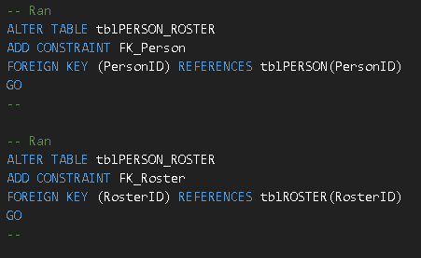
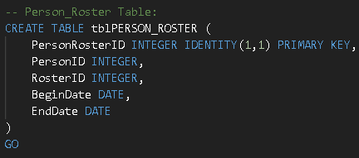
PERSON_ROSTER
-Tells us the begin and end date of a roster and the people in that roster
-Bridge table between PERSON and ROSTER

Slide 7
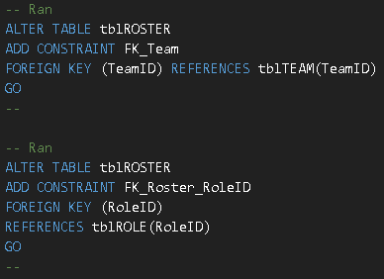
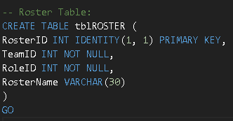
ROSTER
-Tells us how many rosters are in a team
–Transact table

Slide 8
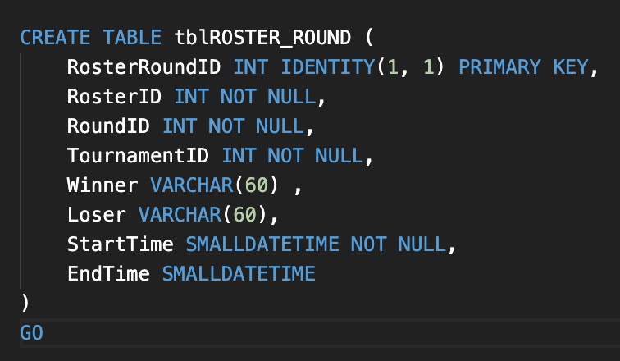
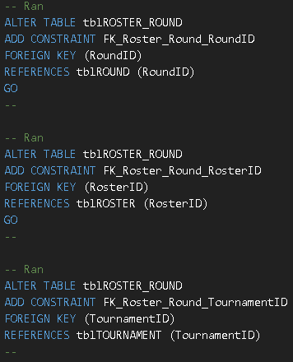
ROSTER_ROUND
Tells us which roster made it to which round.
Allows to directly find specific players and teams that made it into a specific for a tournament

Slide 9
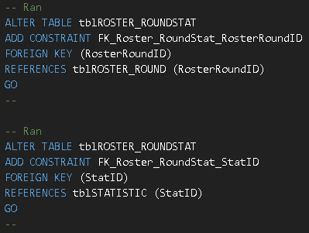
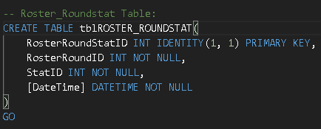
ROSTER_ROUNDSTAT
A bridge table that allows us to find the link the statistics of each roster for each round
Tracks the specific statistics for each roster

Slide 10
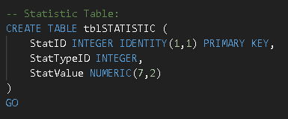
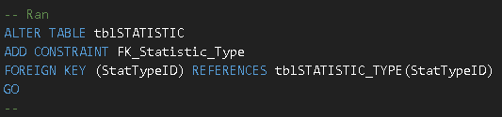
STATISTIC
Tells us the player performance value for each statistic
And links to the statistic type table

Slide 11
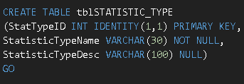
STATISTIC_TYPE
Provides a statistic name and description to each statistic
Provides context for the statistic table

Slide 12
Data Visualization

Slide 13
Thank you! 🎮

